Slide 1
OnTraq
Basement Brogrammers

Slide 2
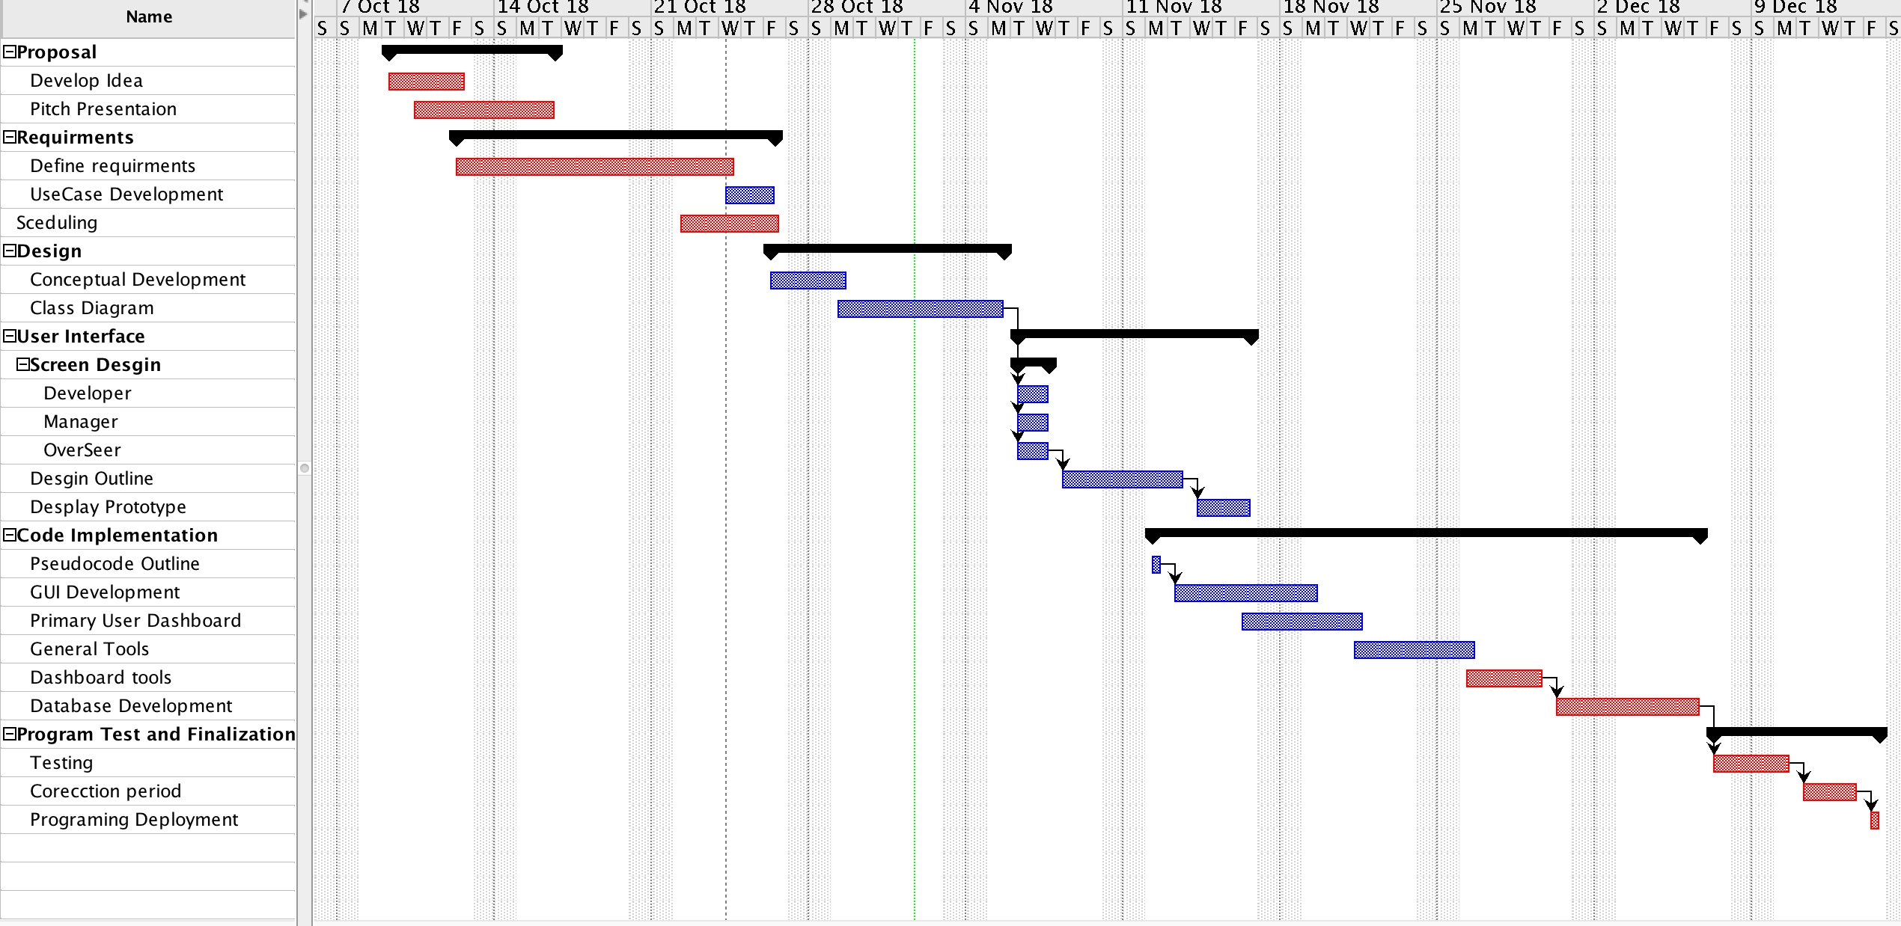
Current Schedule

Slide 3
Developer
Can edit task status (Completed, Started, Not Started)
Most common user, and close second in importance
Can upload files of completed tasks
Manager
Most important
Can assign members to teams
Can assign teams to projects
Can divide projects into tasks and assign team members to them
Can divide tasks into sub-tasks and assign team members to them
Can prioritize tasks
Overseer
Meant for other team members that only need to view the status of the project
Can view the different dashboards and team members, but not edit them.
Interface Breakdown

Slide 4
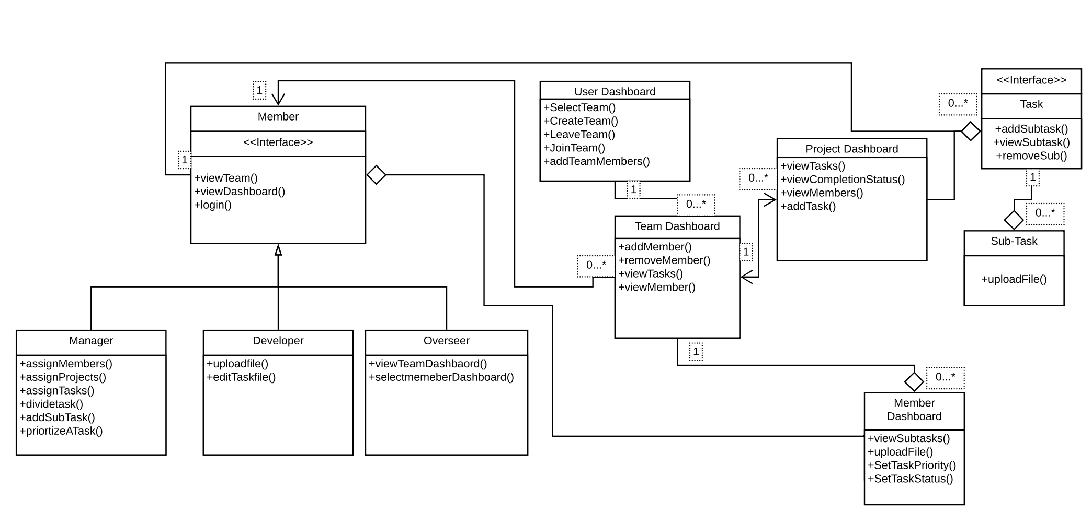
Class Diagram

Slide 5
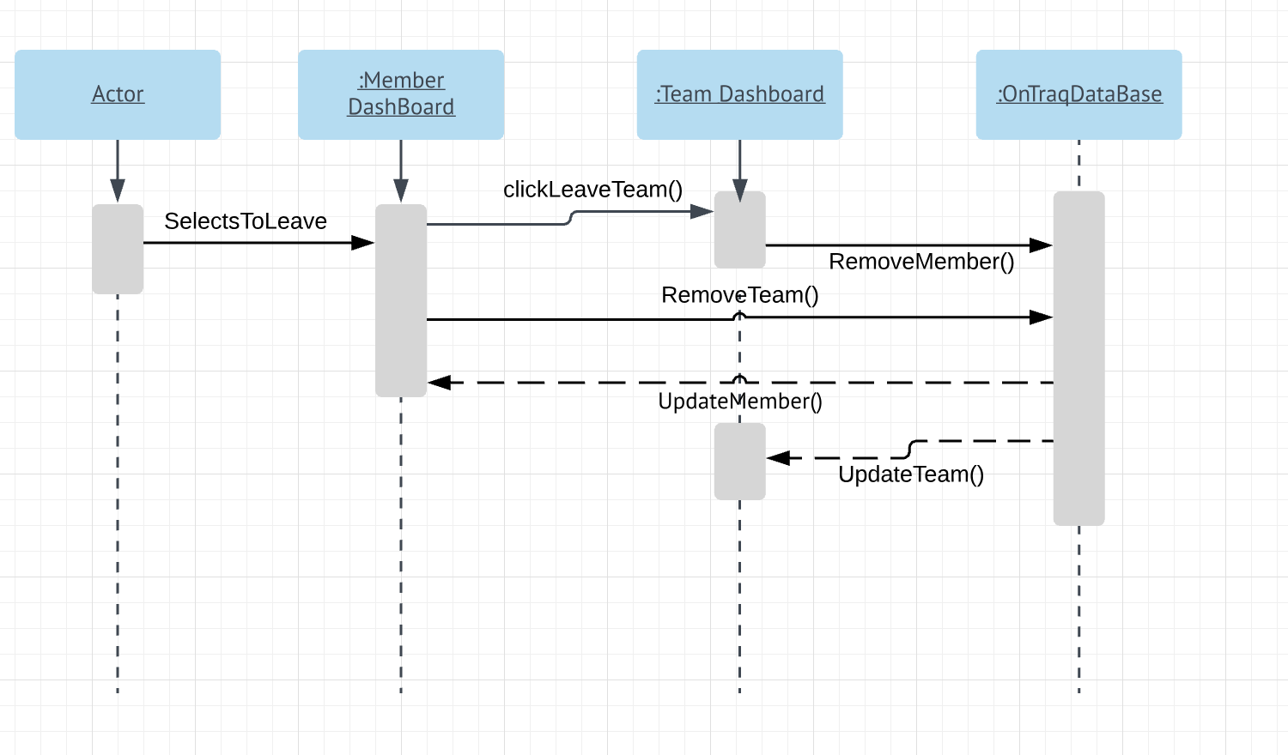
Sequence Diagram: Leaving Team

Slide 6
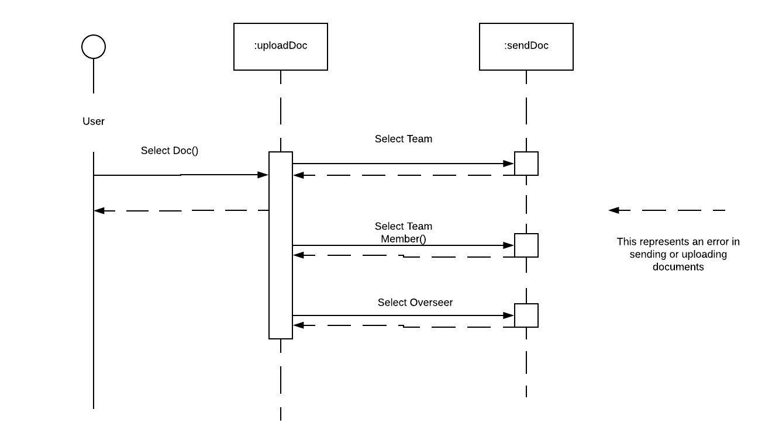
Sequence Diagram: Uploading a file

